Slide 1
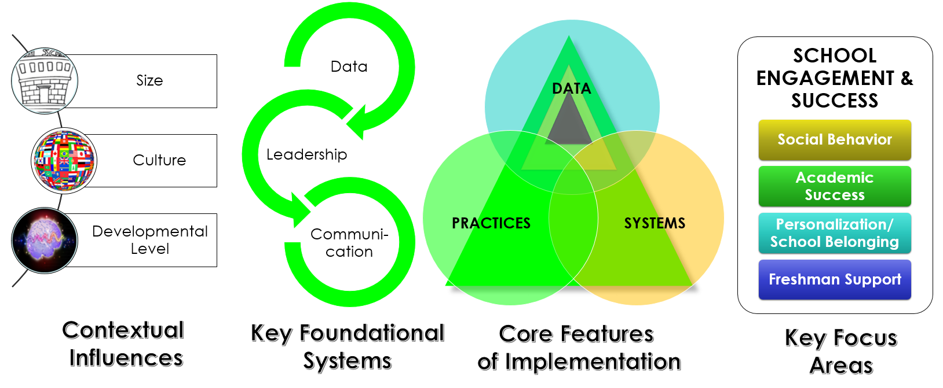
HS-PBIS CoP#3
Hosted by:
Agenda
Classroom-wide PBIS: PRACTICES
Supporting and Responding to Behavior Secondary Classroom Practices (Foundation and Prevention)
Center on Adolescent Research in Schools
Classroom Management Manual (Positive Student-Teacher Interactions and De-escalation Strategies)
Classroom-wide PBIS: SYSTEMS
PBIS in Secondary Classrooms
March 29, 2017
Facilitated by:
Cristy Clouse
cristy@pbiscaltac.org

Slide 2
Rolling Outcomes: Given today’s agenda…
Essential Question:
What are the considerations for high school implementation of PBIS in the classroom?
1 I would like more clarification about……
2 Something new I hope to learn……... 3 I would like to have a deeper understanding about………. 4 I would like to feel ………. 5 I want to experience…….. 6 I am hoping to leave today with……..

Slide 3
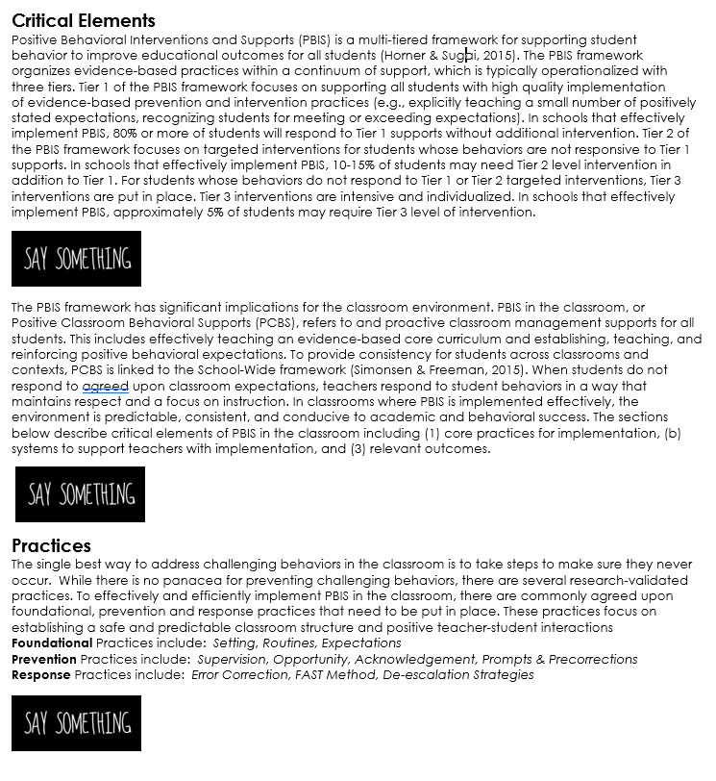
PBIS in the Classroom: PRACTICES .

Slide 4
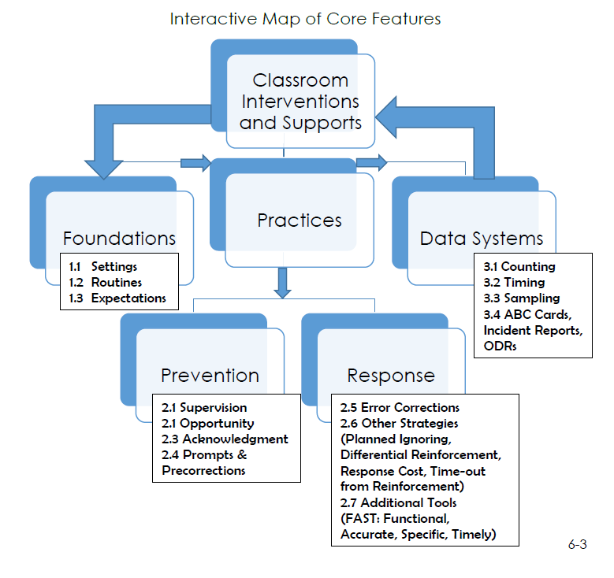

Slide 5
INTERACTIVE MAP of
PCBS Core Features
FOUNDATIONS
1.1 Settings
1.2 Routines
1.3 Expectations
PRACTICES
DATA SYSTEMS
Counting
Timing
Sampling
Office Discipline Referrals
PREVENTION
2.1 Supervision
2.2. Opportunity
2.3 Acknowledgement
2.4 Prompts and Pre-corrections
RESPONSE
2.5 Error Corrections
2.6 Planned Ignoring
2.6. Differential Reinforcement
2.6 Response Cost
2.6 Time Out
Notes:
Cristy
The interactive map provides an organizational layout of the document and some basic definitions of terms that may be helpful to know prior to taking the
self-­assessment. Teachers should begin with the self-­assessment to gauge current classroom management practices. The self-­assessment is designed to help
teachers know where to focus their attention (e.g., foundations, practices, data systems). After teachers take the self-­assessment, the interactive map will
direct them to content that will be most useful. The decision-­making flow chart should be used to help guide teachers in making decisions about making
adjustments within their classrooms.

Slide 6
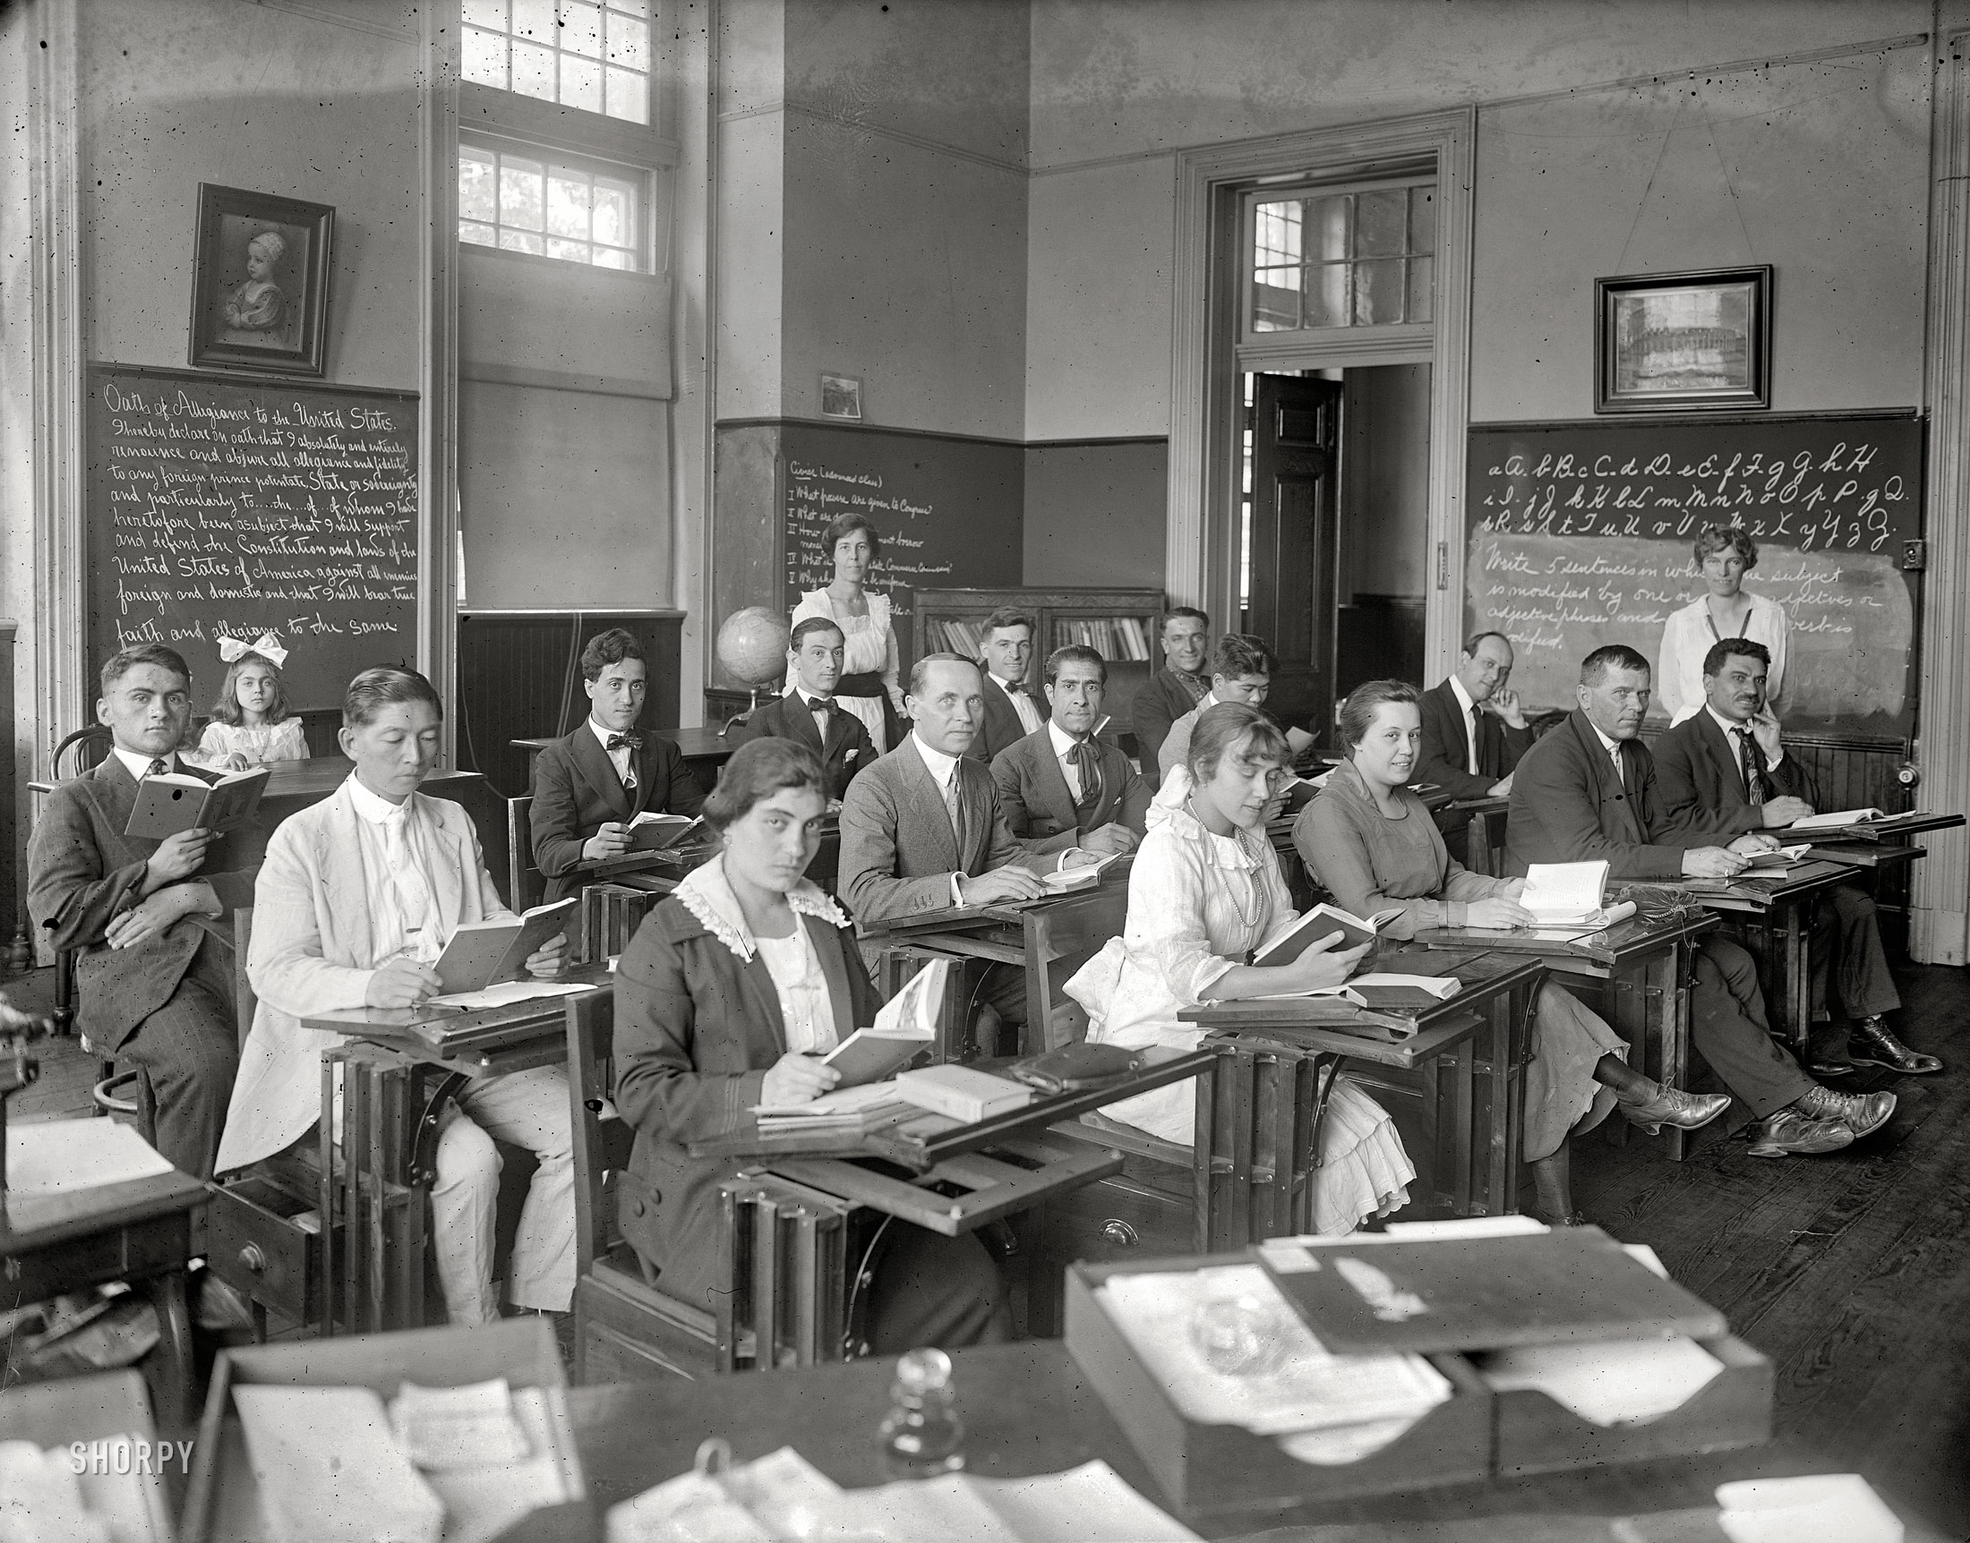
1.1 SETTINGS Effectively design the physical environment of the classroom.
Design classroom to facilitate the most typical instructional activity.
Cooperative Learning
Non-Example

Slide 7
1.1 SETTINGS Effectively design the physical environment of the classroom.
Arrange furniture to allow for smooth teacher and student movement.
Example?
Non-Example?

Slide 8
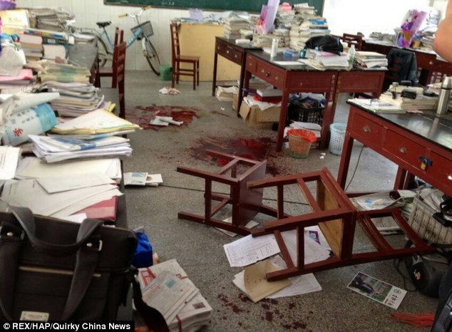
1.1 SETTINGS Effectively design the physical environment of the classroom.
Assure instructional materials are neat, orderly, and ready for use.
Example?
Nonexample?

Slide 9
1.1 SETTINGS Effectively design the physical environment of the classroom.
Post materials that support critical content and learning strategies.
Nonexample

Slide 10
INTERACTIVE MAP of
PCBS Core Features
FOUNDATIONS
1.1 Settings
1.2 Routines
1.3 Expectations
PRACTICES
DATA SYSTEMS
Counting
Timing
Sampling
Office Discipline Referrals
PREVENTION
2.1 Supervision
2.2. Opportunity
2.3 Acknowledgement
2.4 Prompts and Pre-corrections
RESPONSE
2.5 Error Corrections
2.6 Planned Ignoring
2.6. Differential Reinforcement
2.6 Response Cost
2.6 Time Out
Notes:
Cristy
The interactive map provides an organizational layout of the document and some basic definitions of terms that may be helpful to know prior to taking the
self-­assessment. Teachers should begin with the self-­assessment to gauge current classroom management practices. The self-­assessment is designed to help
teachers know where to focus their attention (e.g., foundations, practices, data systems). After teachers take the self-­assessment, the interactive map will
direct them to content that will be most useful. The decision-­making flow chart should be used to help guide teachers in making decisions about making
adjustments within their classrooms.

Slide 11
1.2 ROUTINES Develop and teach predicative classroom routines
Description & Critical Features Establish predictable patterns and routines Promote operation of classroom Outline the steps for completing specific activities Teach routines and procedures directly Promote self-managed or student-guided schedules and routines.
Example Routines: | Agenda/To-Do /Today/s Work Routine | Entering the Classroom | Turning in Assignments | Assignment Tracking
SW Expectations
SW Expectations
SW Expectations

Slide 12
INTERACTIVE MAP of
PCBS Core Features
FOUNDATIONS
1.1 Settings
1.2 Routines
1.3 Expectations
PRACTICES
DATA SYSTEMS
Counting
Timing
Sampling
Office Discipline Referrals
PREVENTION
2.1 Supervision
2.2. Opportunity
2.3 Acknowledgement
2.4 Prompts and Pre-corrections
RESPONSE
2.5 Error Corrections
2.6 Planned Ignoring
2.6. Differential Reinforcement
2.6 Response Cost
2.6 Time Out
Notes:
Cristy
The interactive map provides an organizational layout of the document and some basic definitions of terms that may be helpful to know prior to taking the
self-­assessment. Teachers should begin with the self-­assessment to gauge current classroom management practices. The self-­assessment is designed to help
teachers know where to focus their attention (e.g., foundations, practices, data systems). After teachers take the self-­assessment, the interactive map will
direct them to content that will be most useful. The decision-­making flow chart should be used to help guide teachers in making decisions about making
adjustments within their classrooms.

Slide 13
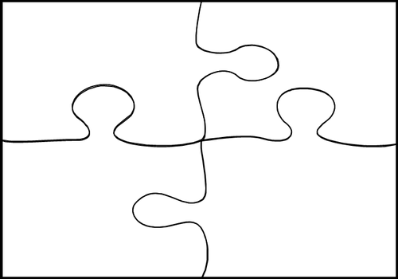
Prevention Practice Jigsaw Description Examples Non Examples
2.1
Supervision
2.2
Opportunity
2.3
Acknowledgment
2.4
Prompts & Precorrects

Slide 14
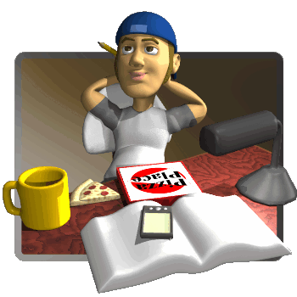
Break Time

Slide 15
Positive Student Teacher Interaction
Praise
Statements
Corrective
Statements
Negative
Statements
Paint a Picture

Slide 16
Positive Student Teacher Interaction
Ways to Enhance Positive Student-Teacher Interactions
Active Supervision | Active supervision promotes the development of a positive classroom climate by proactively encouraging and maintaining student on-task behaviors. Active supervision of students is characterized by patterns of teacher movement and high rates of positive interactions with students, including praise statements and error correction.
Circulating | Circulation in the classroom provides teachers increased opportunities to praise students for on-task behavior, error correction, and encouragement. Teachers should use proximity to check in with students during independent and group work.
Scanning | Frequent visual scanning of the classroom environment is a good way for teachers to observe student behavior related to expectations and routines. General statements of praise or error correction can be made: “I really like how everyone is on task right now. Great work!” “I see students working well in groups together. Excellent!” “I’d like all students to stop. Please remember the homework routine. Homework goes in the blue bin.”
Encouraging | Similar to praise statements, words of encouragement are important messages for students who have emotional and behavioral difficulties. Provide encouragement when students are struggling or have completed a task. Also encourage students to encourage each other! Then be sure to provide students with the appropriate supports (e.g., accommodations) to increase success.
Choices | Providing choices can help redirect undesired behavior and create an opportunity for praise and/or encouragement. When students make a choice to follow expectations, remember to reinforce the appropriate behavior to increase the likelihood that students will repeat the desired behavior. “I see you have not started your math work. Would you like to use scrap paper or graph paper to help you figure the problems?” (Student makes choice and starts to work). “I’m glad to see you on-task now. Raise your hand if you get stuck, and I will be right over to help you.”

Slide 17
Positive Student Teacher Interaction
Positive Student-Teacher Interactions Worksheet
A. Think about the students in your class who display challenging behaviors. Complete the chart to help you reframe negatives into positives.
Student Initials | Behavior | Strategy | Statement Examples
C. What is your goal for increased positive statements to students?
D. What strategy will you use to help you remember to increase positive statements to students?
E. What date will you begin implementation of increased positive student-teacher interactions?

Slide 18
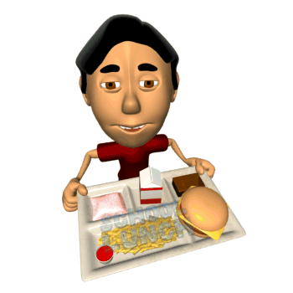
Lunch Time Please be back at 12:35

Slide 19
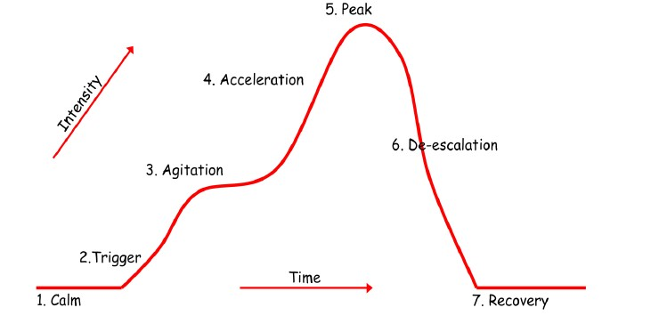
De-Escalation Strategies

Slide 20
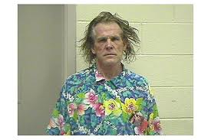
Cycles of Escalation

Slide 21
Cycles of Escalation

Slide 22
De-Escalation Strategies
Phase | Description | Strategy Example | Strategy Non-example
A=Calm
2=Trigger
3= Agitation
5 = Acceleration
6= Peak
7 = De-escalation
8 = Recover

Slide 23
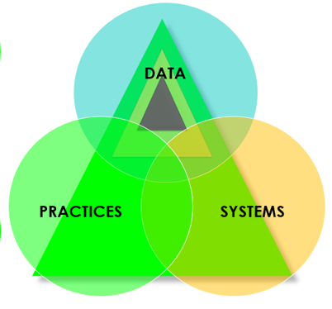
PBIS in the Classroom SYSTEMS
Essential Question:
What are the considerations for high school implementation of PBIS in the classroom?
What practices do you want to implement?
Where are the practices implemented?
Who are your implementation supporters?
How will you support implementation?

Slide 24
Closing Circle
1 A conversation I enjoyed…..
2 A deeper understanding of ……... 3 An idea to share with my staff back at school………. 4 A next step ………. 5 A feeling I am leaving today with …. because…….. 6 An “ah ha” moment ……

